Slide 1
Pizza Management System
API

Slide 2
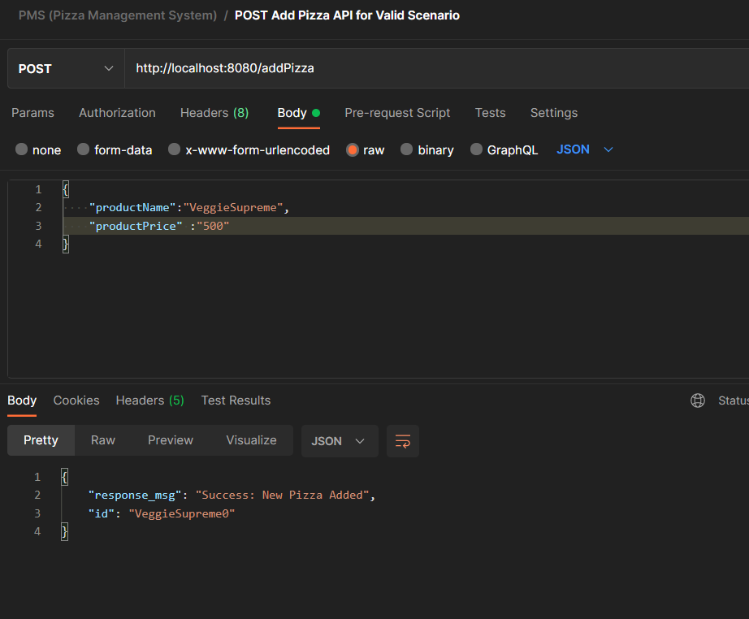
Add Pizza API for Valid Scenario

Slide 3
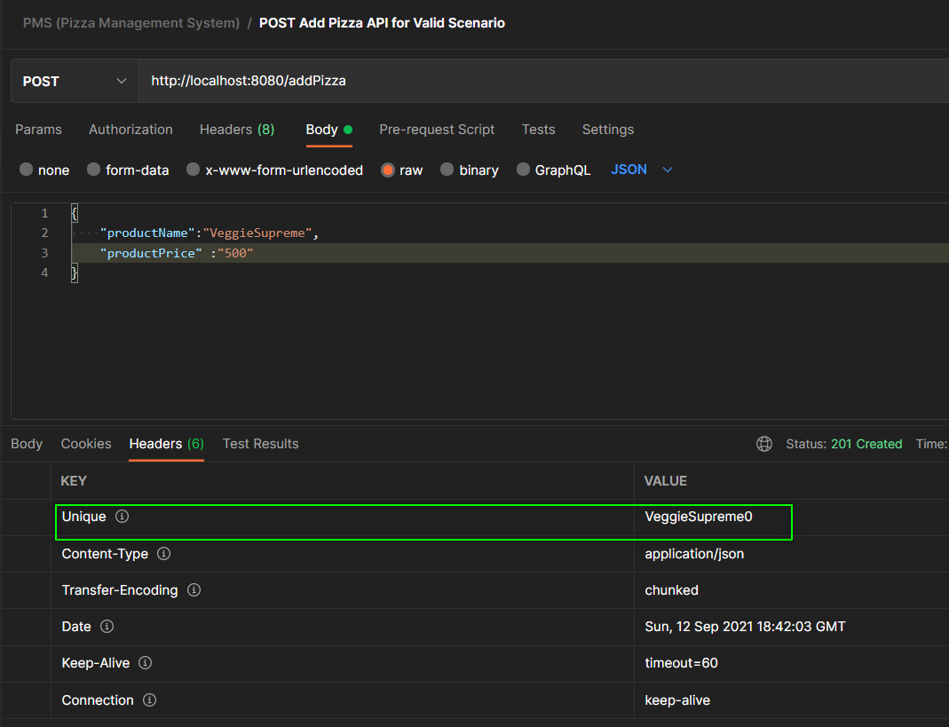
Add Pizza API for Valid Scenario with Custom Header

Slide 4
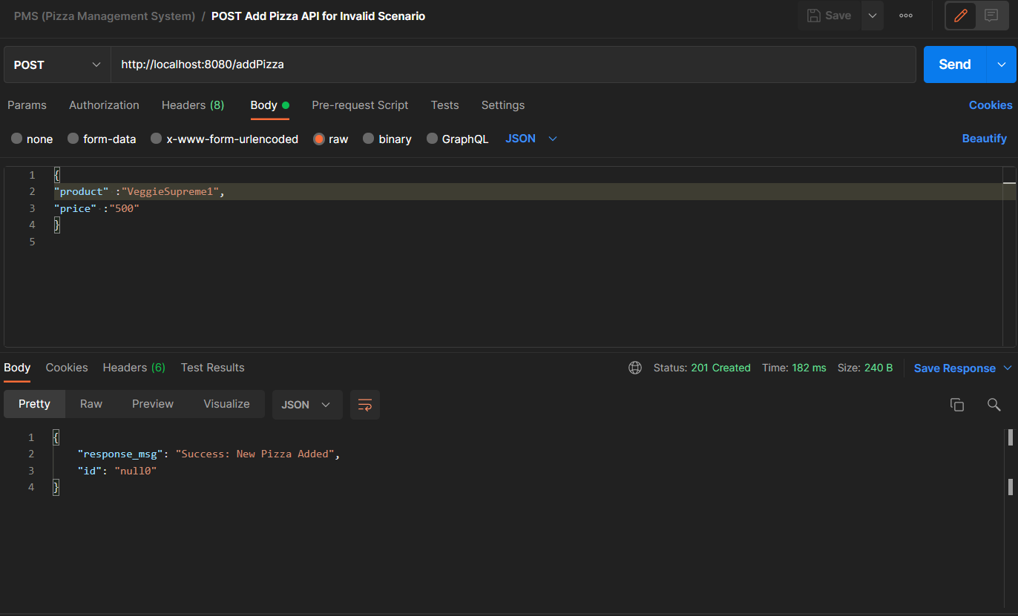
Add Pizza API for Invalid Scenario

Slide 5
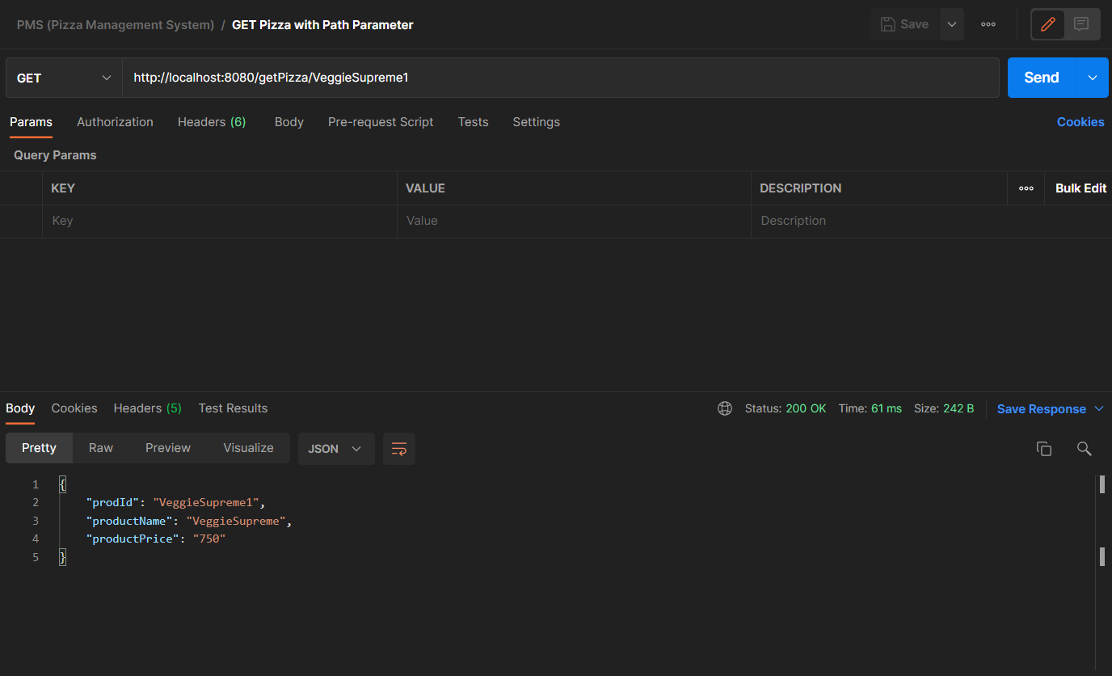
GET Pizza API with Path Parameter Scenario

Slide 6
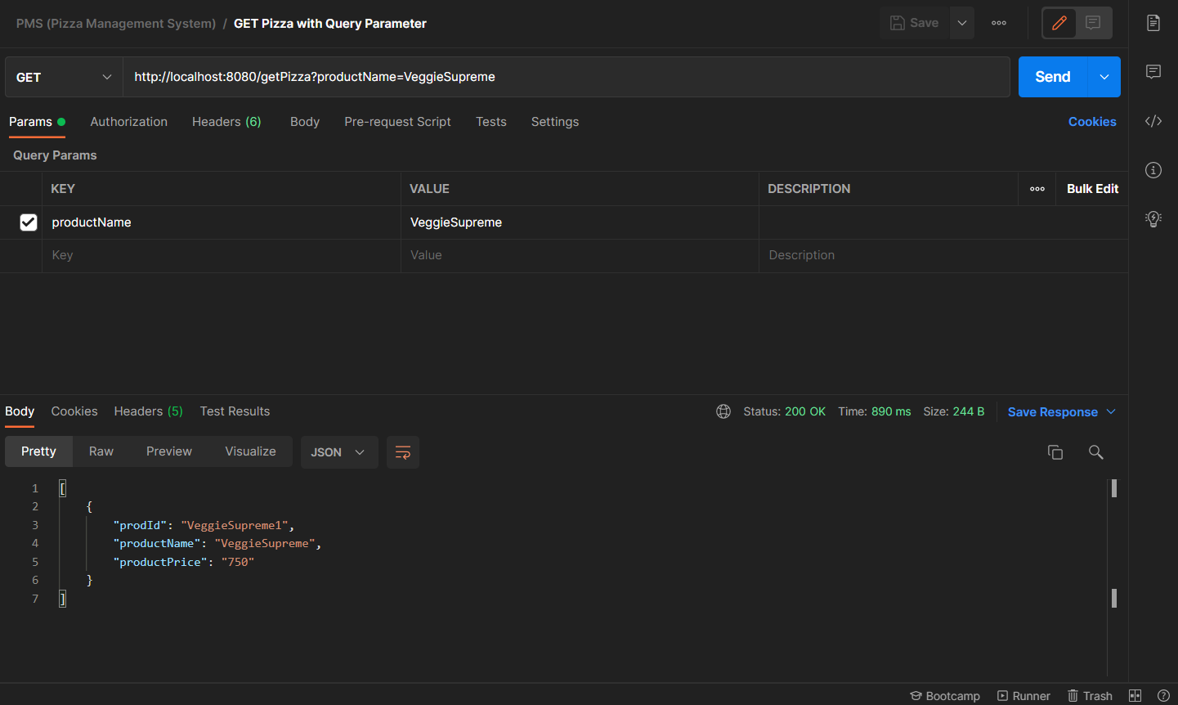
GET Pizza API using Query Parameter

Slide 7
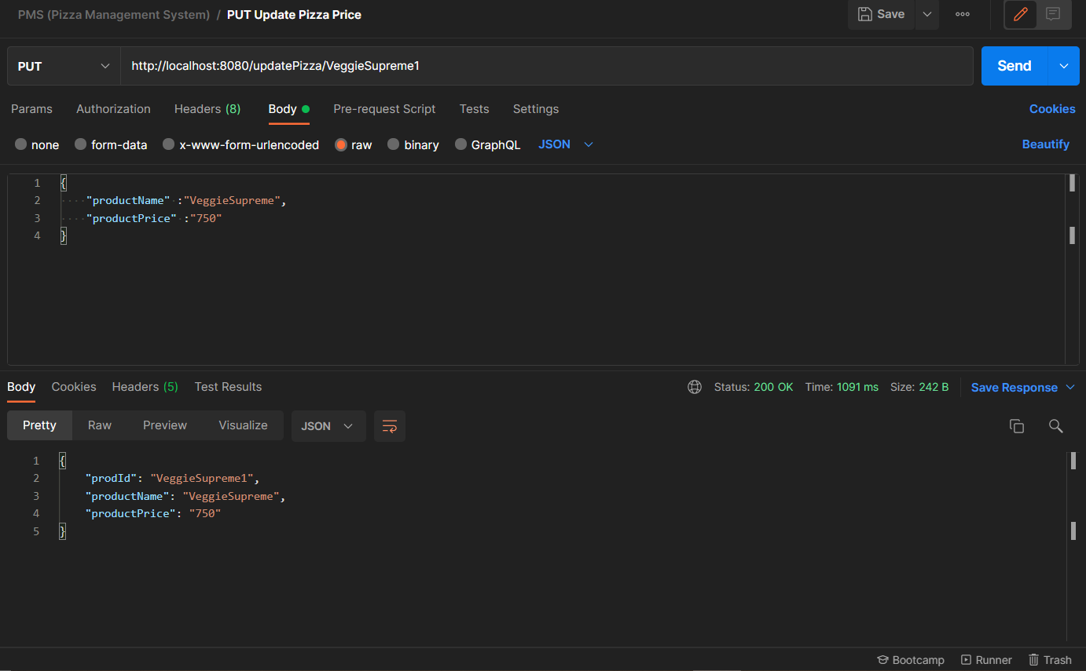
UPDATE Pizza Price API

Slide 8
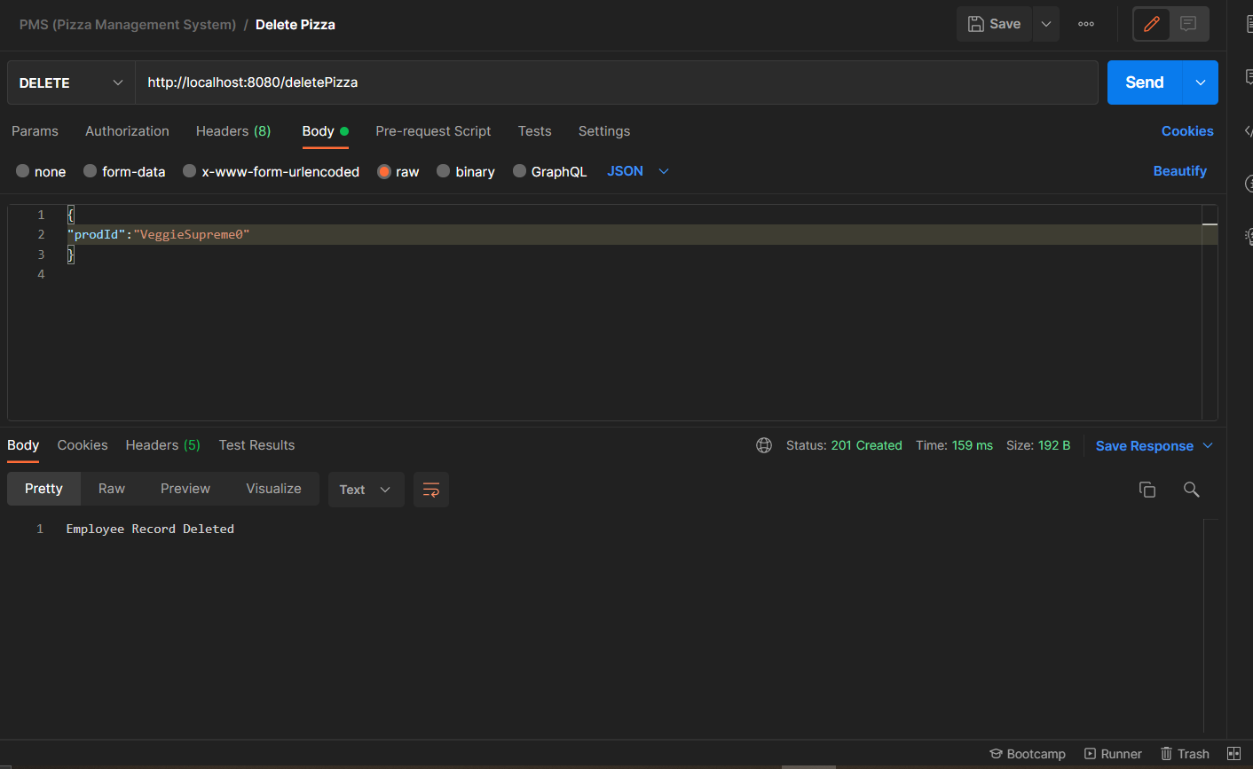
Delete Pizza API

